Slide 1
By contributing to investigations of energy loss due to friction, I can suggest ways of improving the efficiency of moving systems. SCN 3-07a
I have collaborated in investigations into the effects of gravity on objects and I can predict what might happen to their weight in different situations on Earth and in space. SCN 3-08a
By making accurate measurements of speed and acceleration(S3 Physics), I can relate the motion of an object to the forces acting on it and apply this knowledge to transport safety. SCN 4-07b
I can help to design and carry out investigations into the strength of magnets and electromagnets. From investigations, I can compare the properties, uses and commercial applications of electromagnets and supermagnets. SCN 4-08a
Core Content
possible research extensions

Slide 2
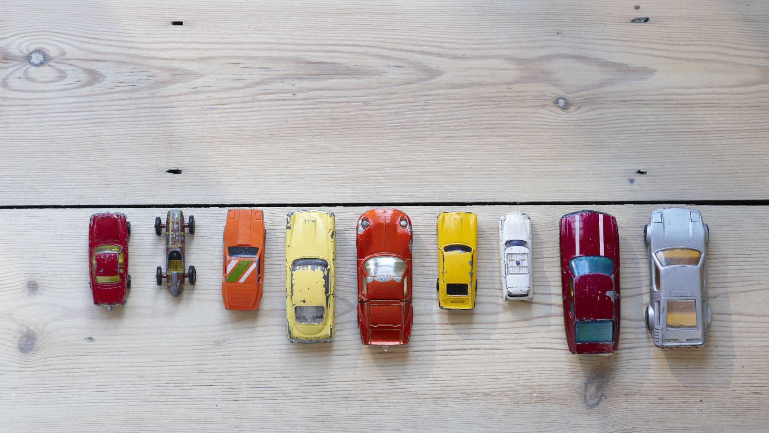
Transport and Forces
S2 Physics - Topic 2

Slide 3
Section 1
Speed

Slide 4
Write down anything you know about Transport

Slide 5
Write down anything you know about Forces

Slide 6
Transport and Forces – Lesson 1
We are learning about
Speed, Distance and Time

Slide 7
Success Criteria:
I can state the symbols for speed, distance and time
I can state the units of speed, distance and time
I can describe what speed is
I can state the speed equation
I can use the speed equation in calculations

Slide 8

Speed
A car travels 60 miles in 1 hour. how many miles does it travel each hour?
A car travels 60 miles in 2 hours. how many miles does it travel each hour?
A car travels 10 meters in 1 second. how many meters does it travel each second?
A car travels 20 meters in 2 seconds. how many meters does it travel each second?
A car travels 10 meters in 5 second. how many meters does it travel each second?

Slide 9

$v=\frac{d}{t}$

Slide 10
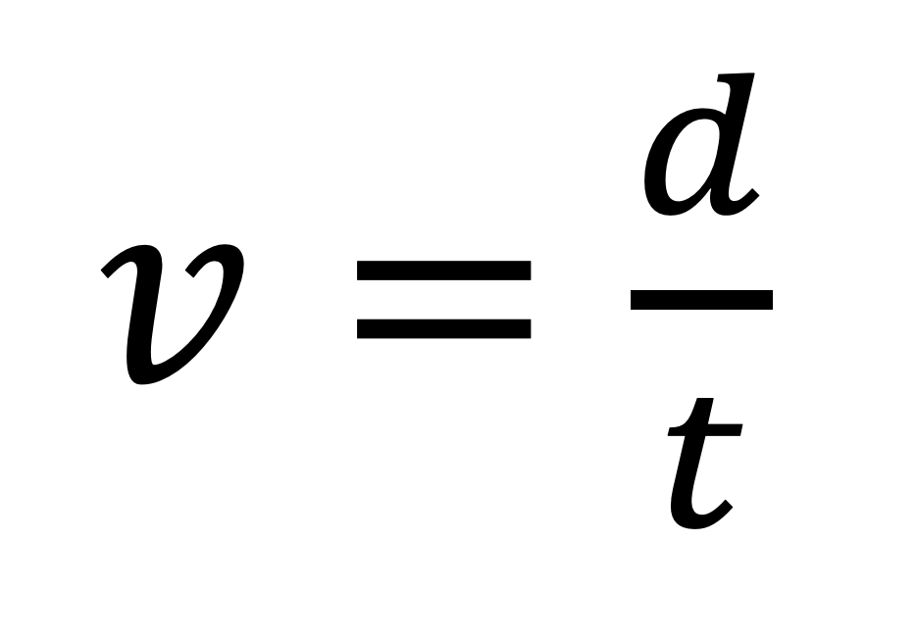
Speed
Distance
$v=\frac{d}{t}$
Time

Slide 11
Speed
(Meters per second)
Distance
(meters)
$v=\frac{d}{t}$
Time (Seconds)

Slide 12
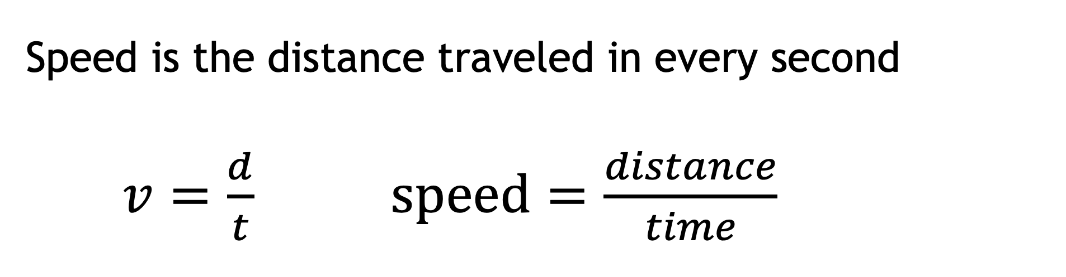
Speed - L1
Speed is the distance traveled in every second
$v=\frac{d}{t}$ $speed=\frac{distance}{time}$
d
v
t
v is speed Units are Meters per second (m/s)
d is distance Units are Meters (m)
t is time Units are seconds (s)

Slide 13


Example 1
A car travels a distance of 12 m in a time of 3 s. calculate the car’s speed.
v = ?
d = 12
t = 3
$$v=\frac{d}{t}$$
$$v=d÷t$$
$$v=12÷3$$
$$v=4 m/s$$

Slide 14
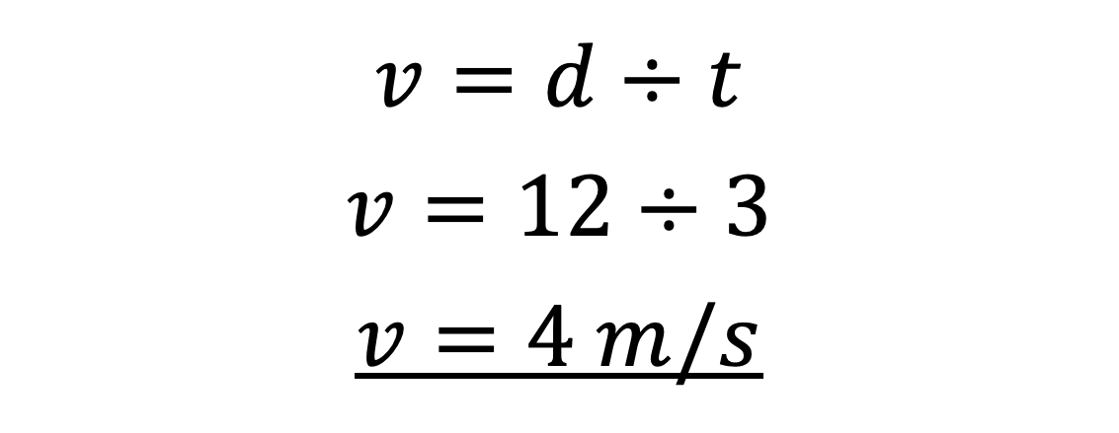
Example 1
A car travels a distance of 12 m in a time of 3 s. calculate the car’s speed.
d
v = ?
d = 12
t = 3
v
t
$$v=d÷t$$
$$v=12÷3$$
$$v=4 m/s$$

Slide 15


Example 2
A car travels a distance of 30 m in at a constant speed of 10 m/s. calculate the time this will take.
$$v=\frac{d}{t}$$
$$t=\frac{d}{v}$$
$$t=d÷v$$
$$t=30÷10$$
$$t=3 s$$
d
v = 10
d = 30
t = ?
v
t

Slide 16

Example 3
A car travels at a constant speed of 20 m/s for a time of 100 s. Calculate the distance the car will travel
$$v=\frac{d}{t}$$
$$d=v × t$$
$$d=20 × 100$$
$$d=2000 m$$
v = 20
d = ?
t = 100
d
v
t

Slide 17
Speed - L1
Speed is the distance traveled in every second
$v=\frac{d}{t}$ $speed=\frac{distance}{time}$
d
v
t
v is speed Units are Meters per second (m/s)
d is distance Units are Meters (m)
t is time Units are seconds (s)

Slide 18


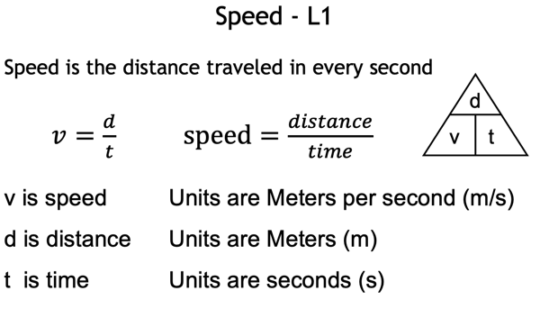
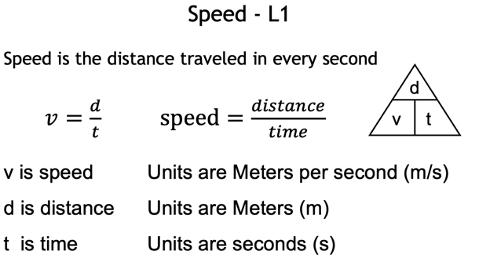
Workbook
QR Code Questions
Easier
Harder

Slide 19
Success Criteria: - (Plenary Link)
I can state the symbols for speed, distance and time
I can state the units of speed, distance and time
I can describe what speed is
I can state the speed equation
I can use the speed equation in calculations

Slide 20
Speed Homework – For Teacher
https://quizizz.com/admin/quiz/61e6fa4b0157b2001e6fa1e5

Slide 21
Daily Review - Whiteboards
What are speed, distance and time measured in
What is the equation/triangle for speed distance and time?
A person runs 20m in a time of 2 seconds. what is their speed?

Slide 22
Transport and Forces – Lesson 2
We are learning about our
own average speed

Slide 23
Success Criteria:
I can explain how to use a trundle wheel
I can calculate my own average speed when I'm running

Slide 24
Measuring Speed - 1
Distance = 20 m
Time 1 =
Time 2 =
Time 3 =
Mean time =
Note: Mean = (T1+T2+T3)÷3

Slide 25
Measuring Speed - 1
Equipment:
Trundle wheel / Measuring Tape
Stopwatch

Slide 26
Measuring Speed – 1 - Method
Measure out a set distance
Mark the start and end
Run along this length
Your partner will time how long you take
Repeat 3 times, record all results

Slide 27
Measuring Speed – 1 - Task
Experiment 1 - L2 – OneNote
Calculate the average time
Use the distance and time to calculate speed
Extra Practice (bottom of OneNote page)
L1 OneNote

Slide 28
Success Criteria:
I can explain how to use a trundle wheel
I can calculate my own average speed when I'm running

Slide 29
Daily Review - Whiteboards
What 2 things must you measure to calculate your own speed?
What is the equation/triangle for speed distance and time?
A person runs 20m in a time of 4 seconds. what is their speed?

Slide 30
Transport and Forces - Lesson 3
We are learning about:
Average speed of a car

Slide 31
Success Criteria:
I can describe what light gates are used for
I can describe how to calculate the average speed of a cart
I can calculate the speed of a cart rolling down a slope
I can describe at least 1pro, and 1 con for average speed
I can explain how to improve the experiment

Slide 32
Measuring Speed - 2
Distance =
Time 1 =
Time 2 =
Time 3 =
Mean time =
Note: Mean = (T1+T2+T3)÷3

Slide 33
Measuring Speed - 2
Equipment:
Meter Stick
Cart with a Flag
2 Light Gates
TSA Box

Slide 34
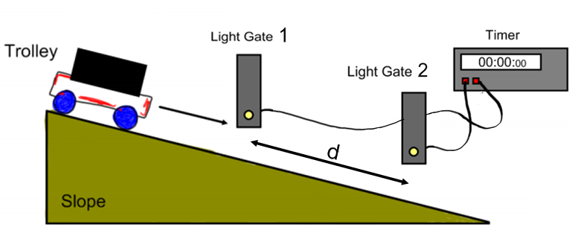
Measuring Speed – 2 - Method
Set up the equipment
Measure the distance between the light gates

Slide 35
Press S until Gap time
Press D
Press G
Release (don’t push) the car from top
Write down time
Reset (G), and repeat 3 times

Slide 36
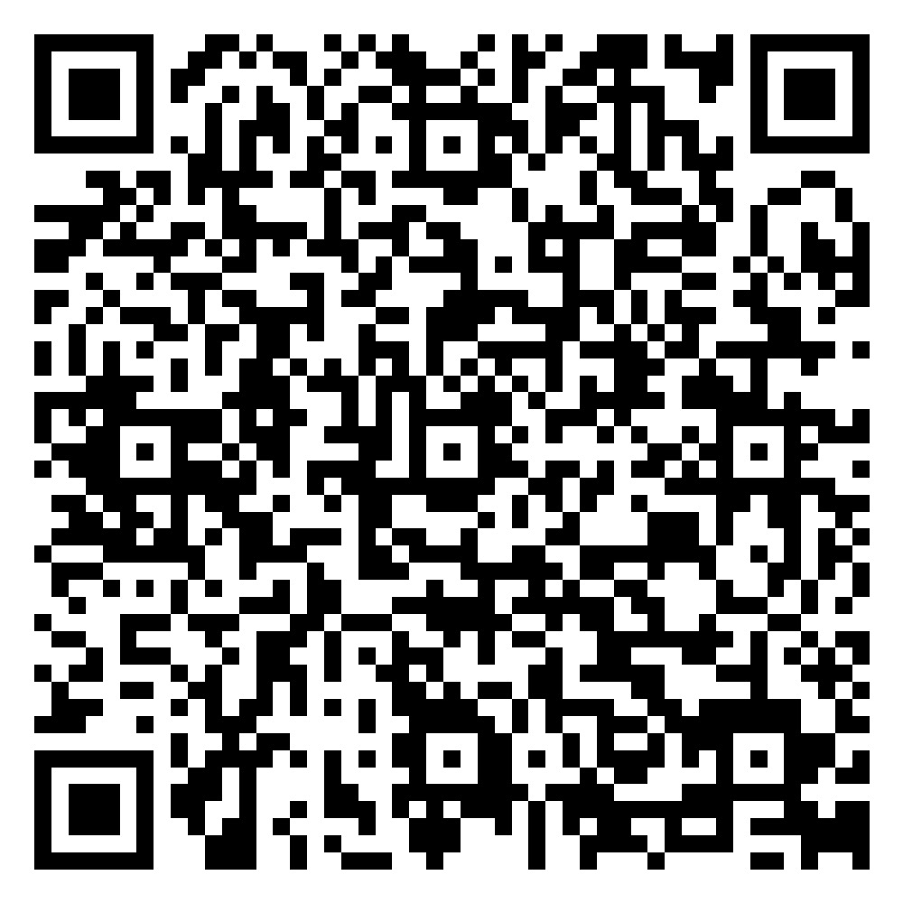
Measuring Speed – 2 – Task
Fill in results on OneNote
Calculate mean time (T1+T2+T3)÷3
Calculate speed
QR code Task
Answer Questions on OneNote L2

Slide 37
Average speed Pros and Cons
Reliable - Values for t/d are large
Made accurate by repeating.
Speed may not be the same for the full distance

Slide 38
Success Criteria: (Plenary link)
I can describe what light gates are used for
I can describe how to calculate the average speed of a cart
I can calculate the speed of a cart rolling down a slope
I can describe at least 1pro, and 1 con for average speed
I can explain how to improve the experiment

Slide 39
Daily Review - Whiteboards
What is the equation/triangle for speed distance and time?
A car travels 100 m in a time of 5 seconds. what is their speed?
What are light gates?

Slide 40
Section 2
Definitions

Slide 41
Daily Review - Whiteboards
What 2 things must you measure to calculate your own speed?
What is the equation/triangle for speed distance and time?
A person runs 25m in a time of 4 seconds. what is their speed?

Slide 42
Transport and Forces
We are learning about:
Forces

Slide 43
Success Criteria:
I can state what a force is
I can state what force a can change
I can state the unit of Force
I can name the device used to measure forces

Slide 44
Forces
A force is a push or a pull.
A force can change:
speed
shape
direction of travel

Slide 45
a stationary object to start moving
a moving object
to speed up
or slow down
a moving object to change its direction
an object to change its shape

Slide 46
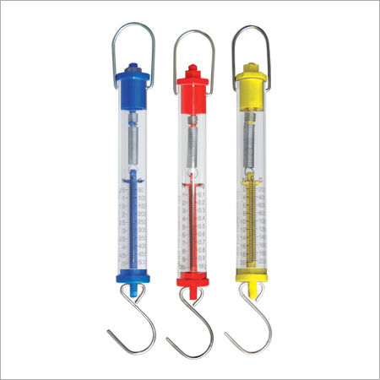
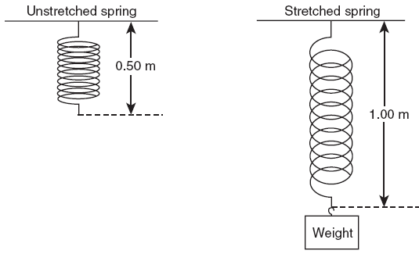
Measuring Forces
The units of force are newtons (N).
Force is measured with a spring balance.
The larger the force the more stretched the spring.

Slide 47
Forces – Task
L3 – Forces – OneNote

Slide 48
Success Criteria - Questions
What is a force?
Push or Pull
What can a force change
Shape, speed, direction
What is the unit of force?
Newtons
What device is used to measure force?
Spring Balance

Slide 49
One of the main forces on Earth is the force due to .
gravity
weight
The name of the force force due to gravity is .
Object | Weight (Newtons – N)
tripod
shoe
test tube rack
hole punch
LO: I know how to measure a force.

Slide 50
Section 3
Resultant, Balanced and Unbalanced Forces

Slide 51
Daily Review - Whiteboards
What is a force?
What can a force change?
What is used to measure forces?
A person walks 60 m in a time of 1 minute. what is their speed? (m/s)

Slide 52
Transport and Forces
We are learning about:
Resultant Forces

Slide 53
Success Criteria:
I can explain the term ‘resultant force’
I can sketch a free body diagram of forces acting on any object
I can use a free body diagram to calculate the resultant force acting on an object

Slide 54
10 N
Object (always draw as a box)
20 N
15 N
10 N
20 N
If forces are in the opposite directions, subtract them to calculate the resultant force
15 N - 10 N = 5 N to the Left
If forces are in the same direction, add them together to calculate the resultant force
10N + 20 N = 30 N to the Right

Slide 55
The resultant force is the overall effect of multiple forces acting on an object
A free body diagram is used to calculate the resultant force.

Slide 56
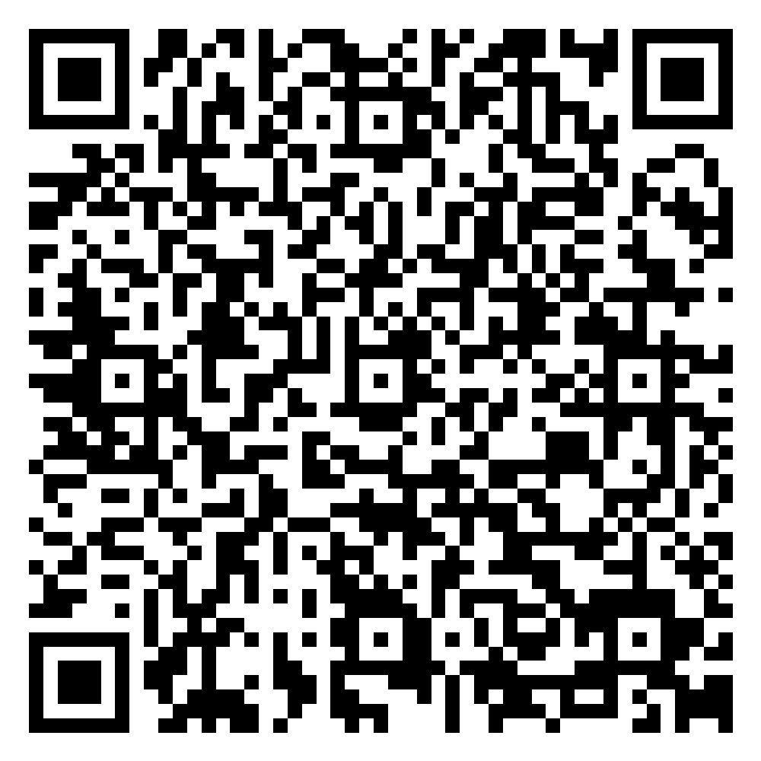

Top QR Code
L4 – OneNote
Bottom QR Code Questions

Slide 57
Success Criteria - Questions
I can explain the term ‘resultant force’
I can sketch a free body diagram of forces acting on any object
I can use a free body diagram to calculate the resultant force acting on an object

Slide 58
Daily Review - Whiteboards
What is a force?
What can a force change?
What is used to measure forces?
A person walks 60 m in a time of 1 minute. what is their speed? (m/s)

Slide 59
Daily Review - Whiteboards
Calculate the resultant force
15 N
20 N

Slide 60
Transport and Forces
We are learning about:
Balances and Unbalanced Forces

Slide 61
Transport and Forces
Success Criteria:
Learning Intentions:
I can explain the term ‘balanced force’
I can explain the term ‘unbalanced force’
I can use a free body diagram to determine if the resultant force is balanced or unbalanced
I can describe what will happen to an object if the resultant force is unbalanced
I can describe what will happen to the motion of an object if the resultant force is balanced
I can use a free body diagram to state if an objects speed will increase or decrease.
We are learning about balanced and unbalanced forces

Slide 62
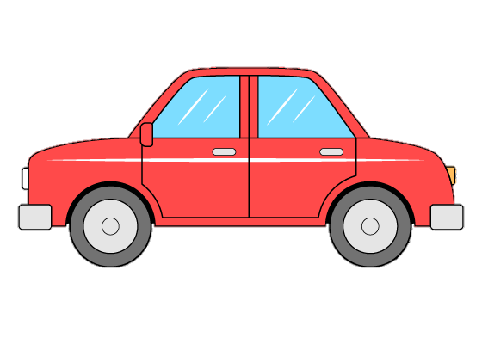
100N from engine
100 N air resistance
Resultant Force =
0 N – Balanced

Slide 63
100N from engine
50 N air resistance
Resultant Force =
50 N Forward – Unbalanced

Slide 64
100N
100 N
Resultant Force =
200 N Forward –Unbalanced

Slide 65
100N
Resultant Force =
100 N Back –Unbalanced

Slide 66
Balanced - Forces are Equal but opposite direction.
Resultant equal to 0N
Unbalanced - There is more force on one side
Resultant not equal to 0N

Slide 67
100N from engine
10N air resistance
Resultant Force =
90N to the right
Car =
Speeds up

Slide 68
40N from engine
120N from brakes
Resultant Force =
80N to the left
Car =
Slows down

Slide 69
Unbalanced Forces
When forces acting on car are unbalanced, the car will change speed and/or direction.

Slide 70
100 N from engine
100N from brakes
Resultant Force =
0N
Car =
Stays the same speed

Slide 71
balanced Forces
Newton's 1st Law:
When forces on a car are balanced it will remain stationary
or continue to move at a constant speed in a straight line.

Slide 72
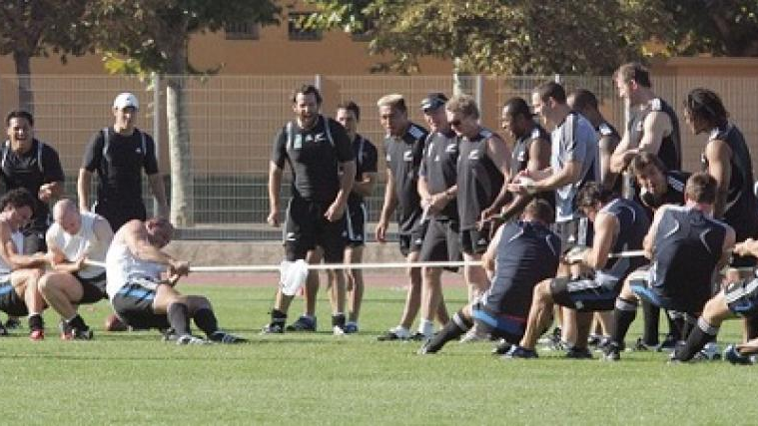

Slide 73
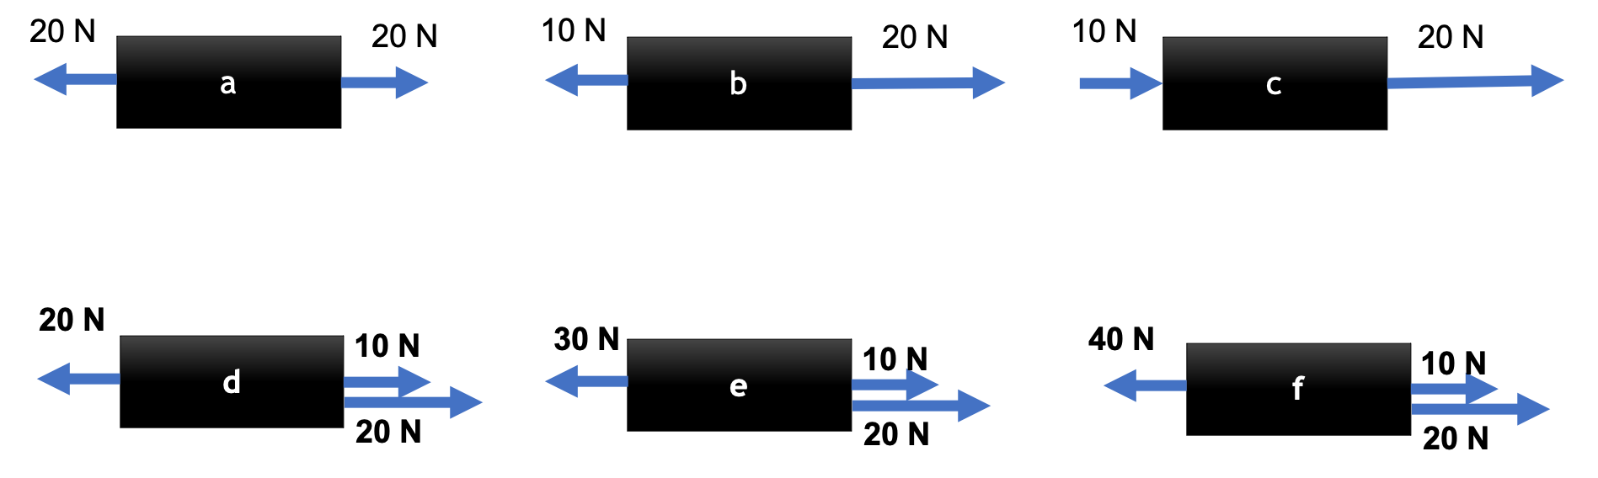
Balanced Forces – Task
Calculate the value of the resultant force
State the direction of the resultant force
State whether the force is balanced or unbalanced
Extension - Yellow Book Questions (Page 15, 1,2,4,5)

Slide 74
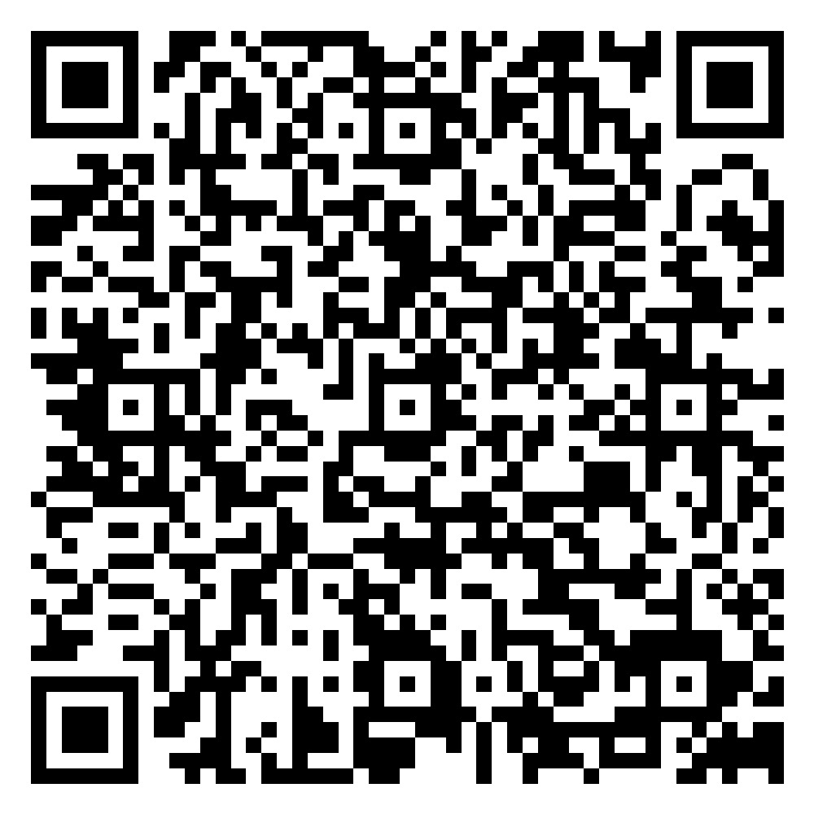
Resultant Forces – Task
QR Code
L5 – OneNote
Yellow Book Questions (Page 15, Q1,2,4,5)

Slide 75
Success Criteria
Explain the term ‘balanced force’
Explain the term ‘unbalanced force’
What is a free Body Diagram?
What will happen to the motion of a moving car if forces are balanced?
What will happen to the motion of a moving car if forces are unbalanced?

Slide 76
Daily Review - Whiteboards
What are the 3 things a force can change?
Resultant Force, and effect on speed:

Slide 77
100N from engine
10N air resistance
Resultant Force =
90N to the right
Car =
Speeds up

Slide 78
40N from engine
120N from brakes
Resultant Force =
80N to the left
Car =
Slows down

Slide 79
100 N from engine
100N from brakes
Resultant Force =
0N
Car =
Stays the same speed

Slide 80
Transport and Forces
We are learning to be able to:
Present to the class information we have discovered

Slide 81
Daily Review
What makes a Presentation good?

Slide 82
Transport and Forces
Success Criteria: - Research Stage
I can research an aspect of transport and forces using the internet.
I can reference any websites I get information from
I can explain any information I choose to use in my own words
Learning Intentions:
We are learning about balanced forces

Slide 83
Transport and Forces
Success Criteria: - PowerPoint Stage
I can present information in a clear and precise way
I can relate my information to something done in class
I can add relevant images to support the information
I must add all information before formatting
Learning Intentions:
We are learning about balanced forces

Slide 84
Transport and Forces
Success Criteria: - Presenting Stage
I can make eye contact with the audience
I can speak loud and clear
I can use flashcards to remind me what I need to say
We can plan what each person is going to say and when
Learning Intentions:
We are learning about balanced forces

Slide 85
Ideas
Transport Safety
Acceleration
Improving Vehicles Performance
Electromagnets
Super magnets

Slide 86
6 Slides including Title and References

Slide 87
Learning Logs
Title: Forces Presentation
Score: /20
Comment: something good and something for improvement

Slide 88
Section 4
Friction

Slide 89
Daily Review - Whiteboards
What is a force?
What are the 3 things a force can change?

Slide 90
100N from engine
10N air resistance
Resultant Force =
90N to the right
Car =
Speeds up

Slide 91
40N from engine
120N from brakes
Resultant Force =
80N to the left
Car =
Slows down

Slide 92
100 N from engine
100N from brakes
Resultant Force =
0N
Car =
Stays the same speed

Slide 93
Transport and Forces
We are learning about
Friction

Slide 94
Transport and Forces
Success Criteria:
Learning Intentions:
I can state what friction is
I can state the energy change involved in friction
I can state the direction friction acts
I can describe how frition and engine force relate to the speed of a car
We are learning about friction

Slide 95
Friction
Aim:
To investigate how material effects force required to move a block.
Prediction:
The material that will need the most force to move the block will be _____.

Slide 96
Friction
Surface | Force Required (N)
Bench
Floor
Carpet
Laminate
Sandpaper

Slide 97
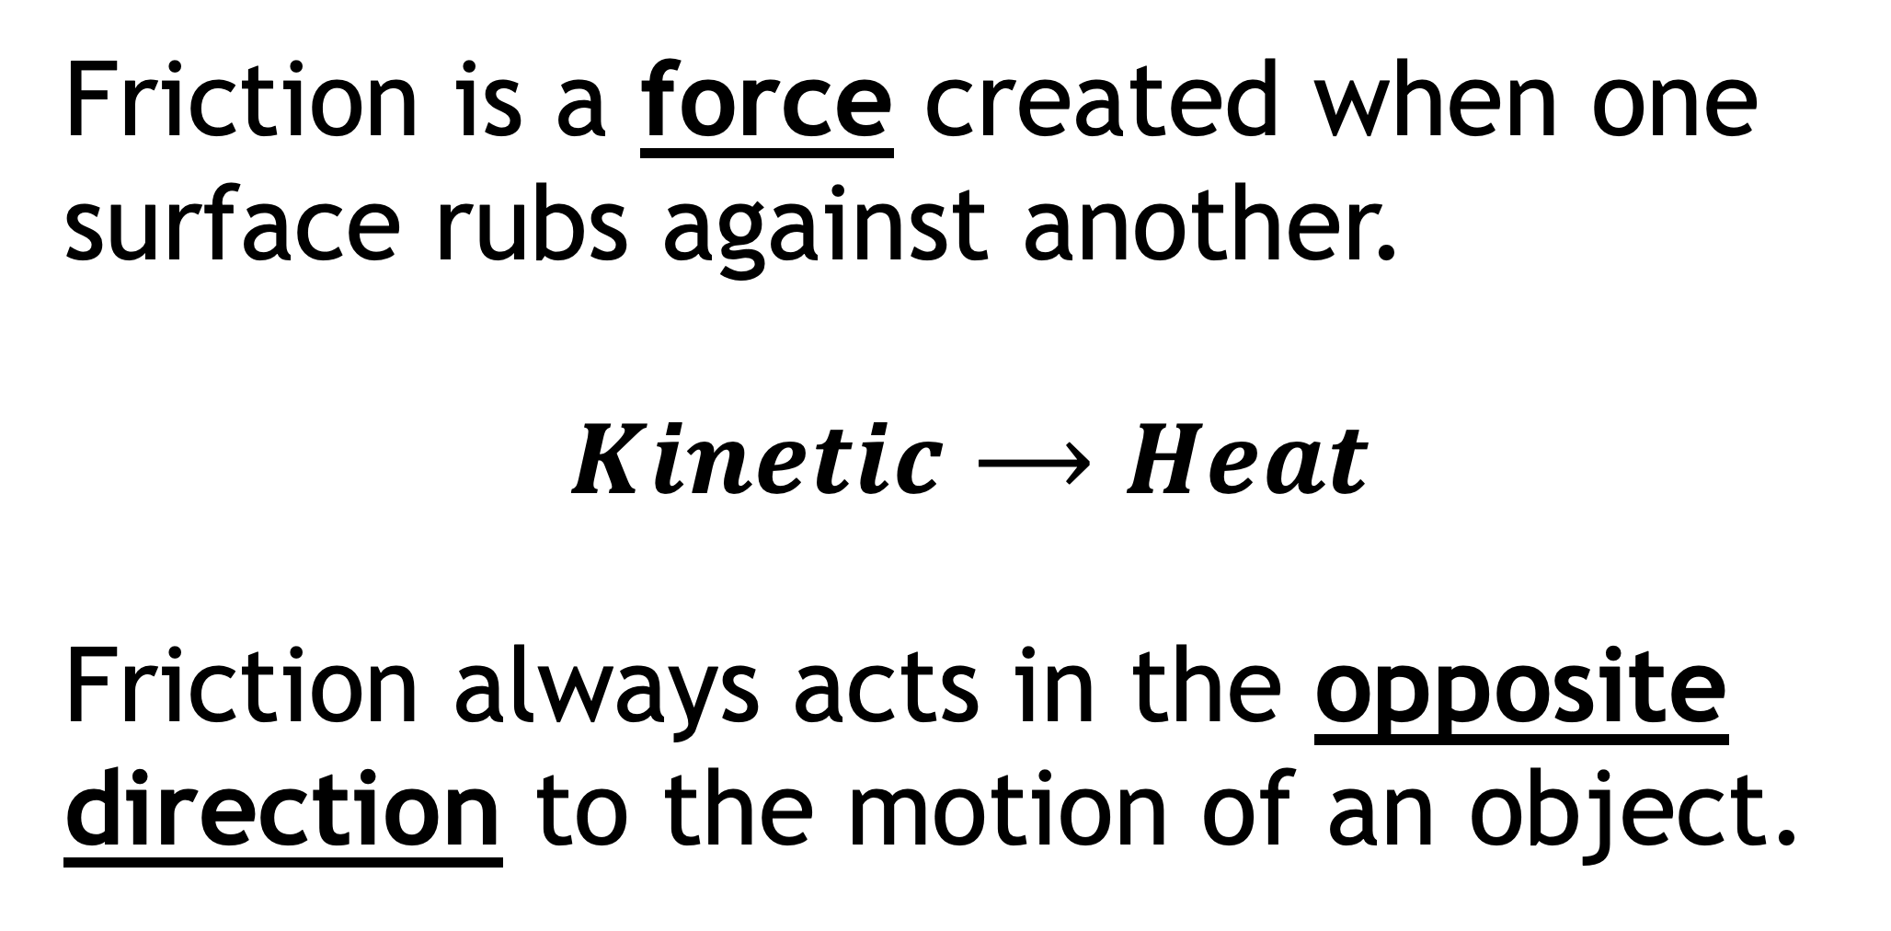
Friction
Friction is a force created when one surface rubs against another.
$$Kinetic⟶Heat$$
Friction always acts in the opposite direction to the motion of an object.

Slide 98

Friction and Transport
When the force of friction is equal to the engine force of a car it will move at a constant speed
When the force of friction is less than the engine force of a car, the speed will increase (Accelerate)
When the force of friction is greater than the engine force of a car, the speed will decrease (decelerate)

Slide 99
Friction and Transport
If friction is equal to engine force | Constant speed
If friction is less than engine force | Increase speed
If friction is more than engine force | Decrease speed

Slide 100
Friction – Task – Jotter - Sentences
What is friction?
What are the units of friction?
What can be said about an object when the forces on it are balanced?
Think about a bike and all the places you need friction, write about other sporting activities where friction may be useful.
L6 – OneNote (until applications)

Slide 101
Success Criteria
What is friction?
What is the friction energy change?
What direction does friction act?
If the engine forces if greater than friction, what will happen to the speed of the car?

Slide 102
Daily Review - Whiteboards
What is friction?
What is the friction energy change?
What direction does friction act?
If the engine forces if less than friction, what will happen to the speed of the car?
What equipment could we use to calculate the speed of a toy car?

Slide 103
Transport and Forces
We are learning about
Applications of friction

Slide 104
Success Criteria:
I can give at least 2 examples of when friction is useful
I can give at least 2 examples of when friction is a nuisance
I can state at least 2 ways to reduce friction

Slide 105
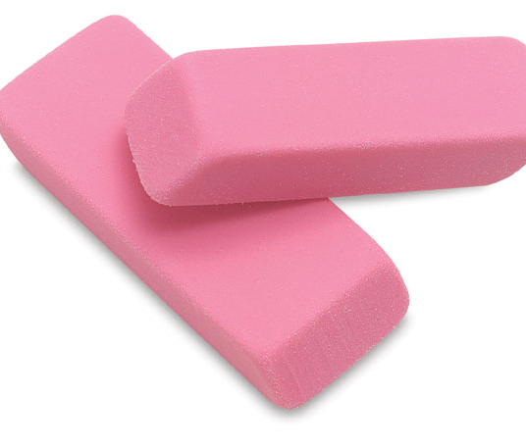
Useful Friction
Bike Breaks
Car Tires
Soles of Shows
Sawing a plank of wood
Rubbing out pencil

Slide 106
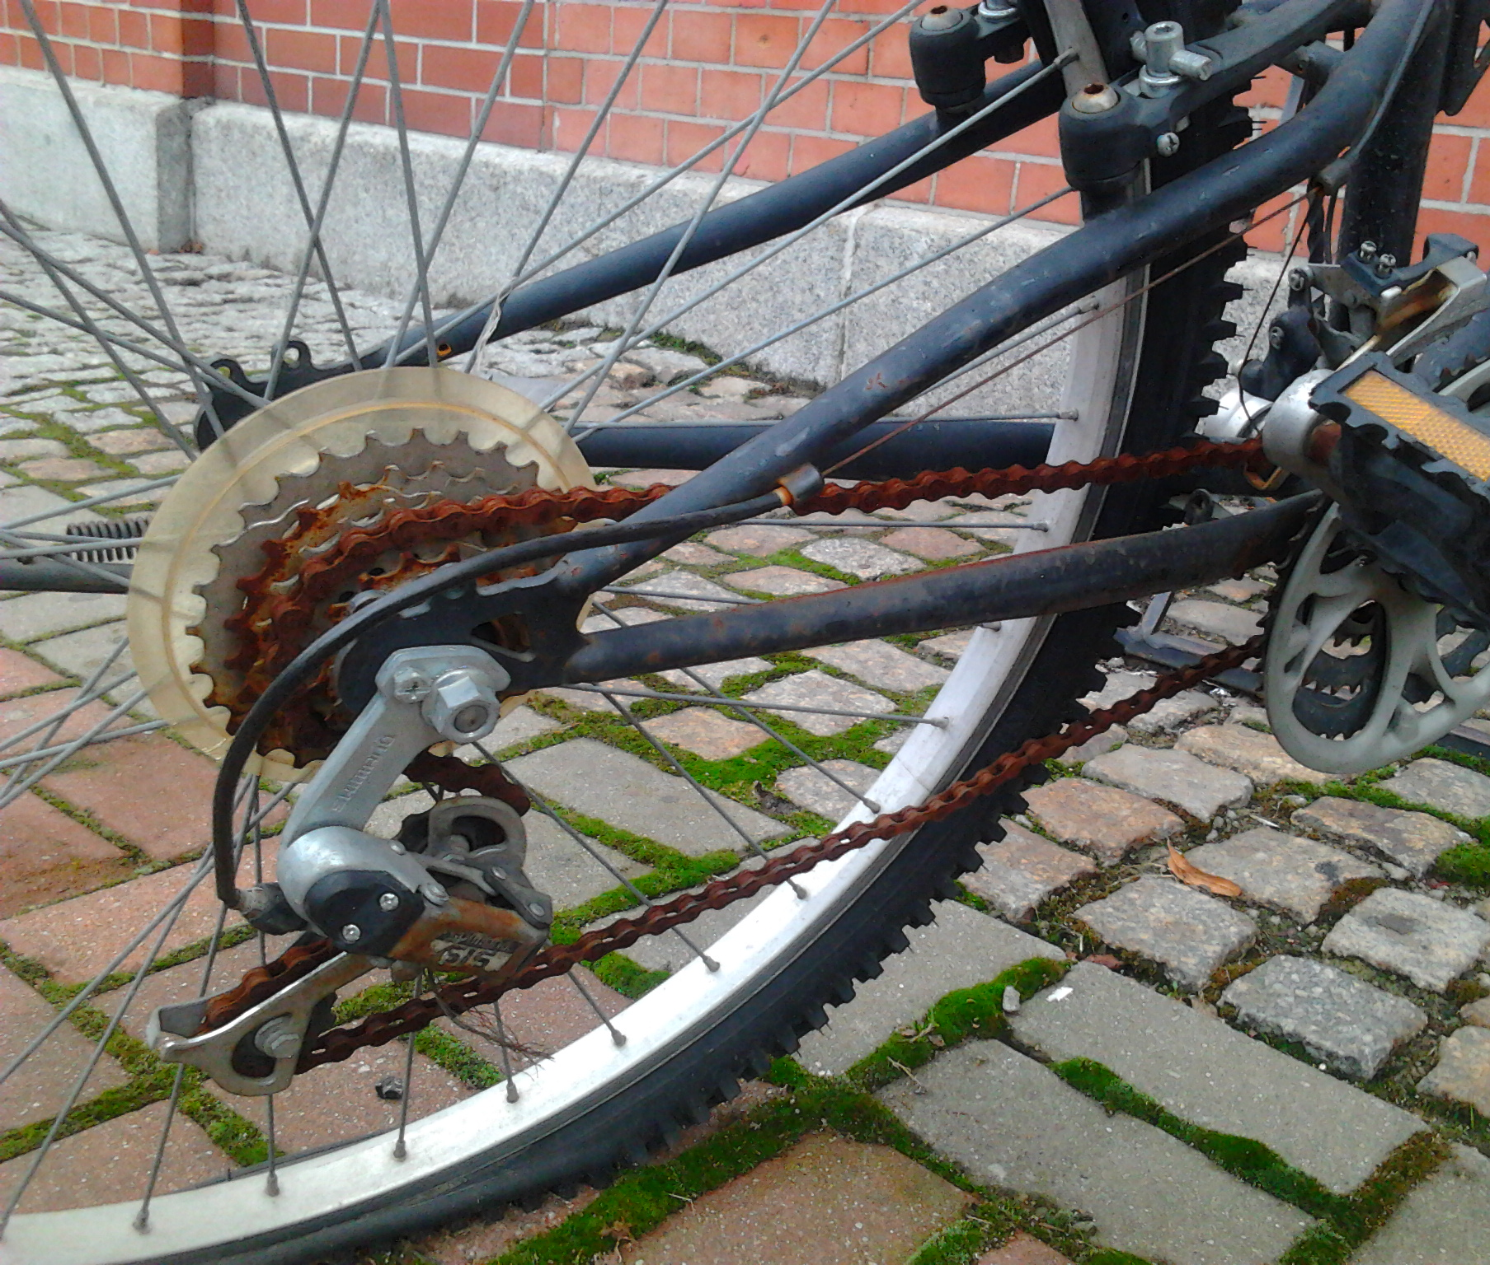
Nuisance Friction
Bike chain
Car Engine
Sledge runners
Air resistance
Rope Burns

Slide 107

Reducing Friction
Lubrication
Smoothing the surface
Reducing the Force

Slide 108
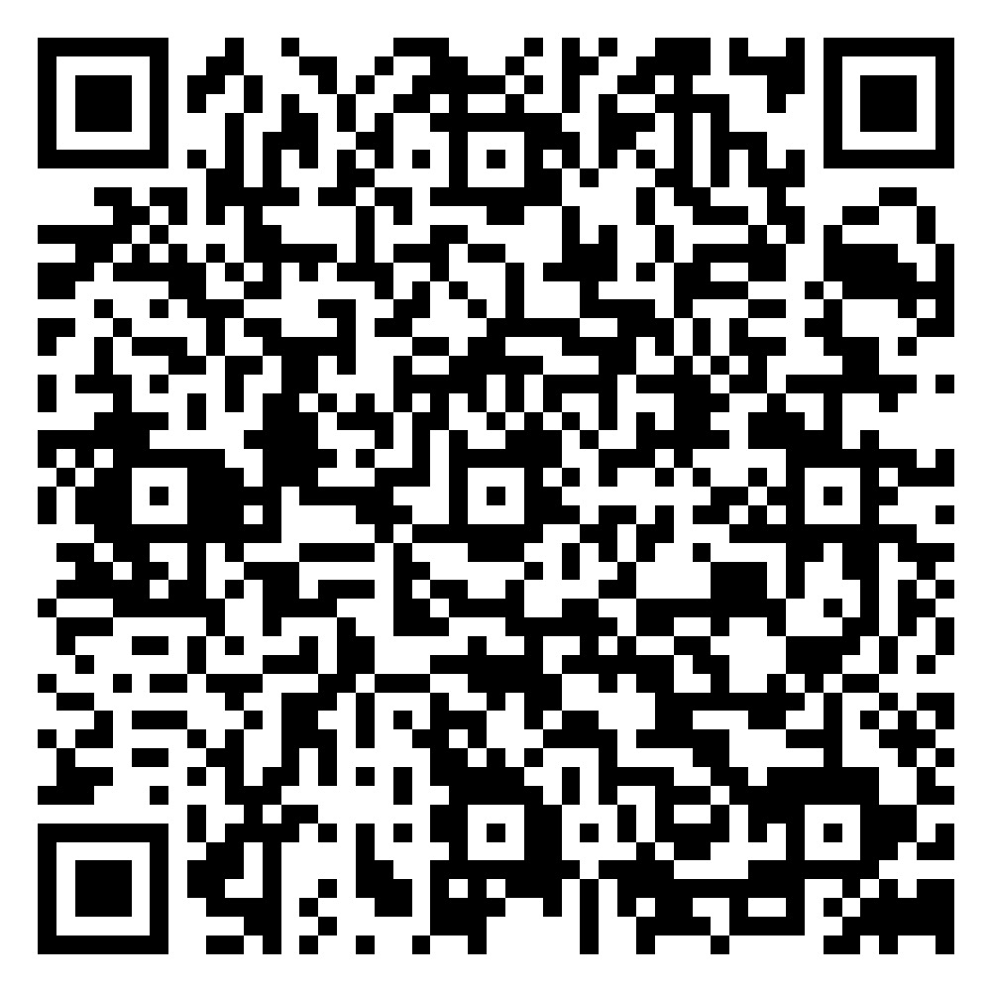
Mid Topic Review
QR Code
L6 Friction OneNote, S2 Physics, Transport and forces

Slide 109
Success Criteria
Give at least 2 examples of when friction is useful
Give at least 2 examples of when friction is a nuisance
State at least 2 ways to reduce friction

Slide 110
Daily Review - Whiteboards
What is friction?
What is the friction energy change?
How can you reduce friction?
When is friction useful?
If the engine forces if less than friction, what will happen to the speed of the car?
What equipment could we use to calculate the speed of a toy car?

Slide 111
Section 5
Examples of
Forces

Slide 112
Transport Forces
We are learning about
Mass and Force

Slide 113
Mass and Force
Through experimentation I can discover the link between mass and force
I can describe mass
I can state the units of mass

Slide 114
Mass and Force
Aim:
To investigate how mass and force due to gravity are related

Slide 115
Mass and Force
Object | Mass (kg) | Force (N)
Shoe
Stapler
Pencil Case
Human

Slide 116
Daily Review - Whiteboards
How can you reduce friction?
When is friction useful?
What units is mass measured in?
What units is weight measured in?

Slide 117
Transport Forces
We are learning about
Mass and Weight

Slide 118
Success Criteria:
I can describe weight
I can state the units of weight
I can describe gravitational field strength
I can state the units of gravitational field strength
I can state the equation that links mass and weight
I can apply the equation to questions

Slide 119
Gravitational Force
A Gravitational field causes one object (person) to feel a pull to another large object such as planets
The larger the mass of the planet, the stronger the gravitational field.

Slide 120
Gravitational Force
The gravitational field strength is different on each planet.
The larger the gravitational field strength, the greater the force an object will feel on the surface of the planet.

Slide 121
Mass and Weight
Mass is measured in kilograms (kg).
Mass is the measure of the amount of matter in an object.
Weight is measured in Newtons (N).
Weight is the measure of the force due to gravity acting on an object.

Slide 122
Mass and Weight
Gravitational field strength is measured in newtons per kilogram (N/kg)
Earth has a gravitational field strength of 10 N/kg.

Slide 123
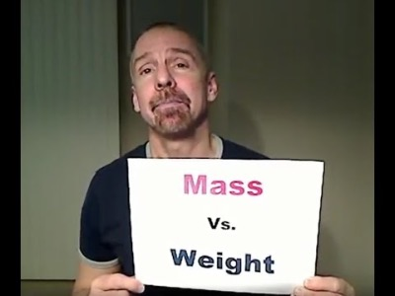

Slide 124
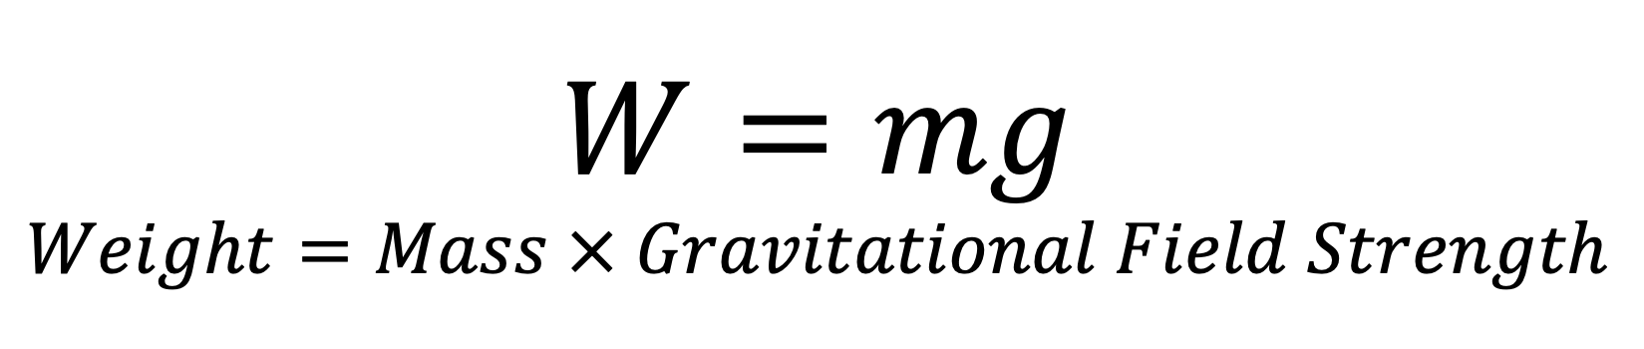
Mass and Weight - Equation
$$W=mg$$
$$Weight=Mass × Gravitational Field Strength$$
W
m
g
W Weight Newtons (N)
m Mass Kilograms (kg)
g Gravitational field strength Newtons per Kilogram (N/kg)

Slide 125
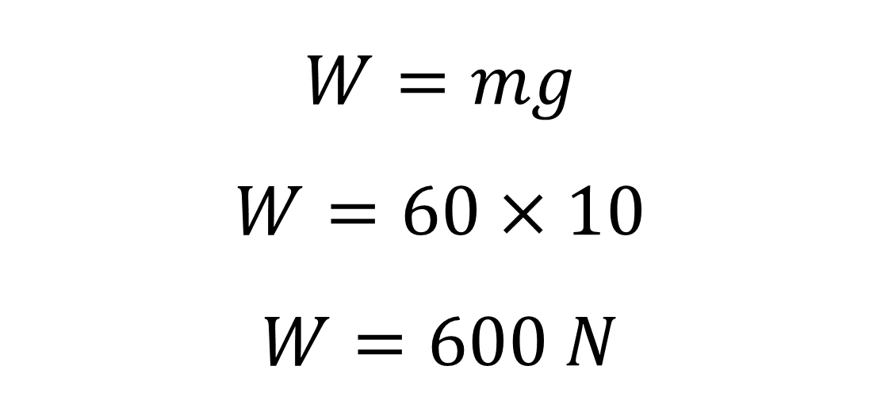
Example 1 – Weight On Earth
Calculate the Weight of a person who has a mass of 60kg
W= ?
m= 60
g= 10
$$W=mg$$
$$W=60×10$$
$$W=600 N$$
W
m
g

Slide 126
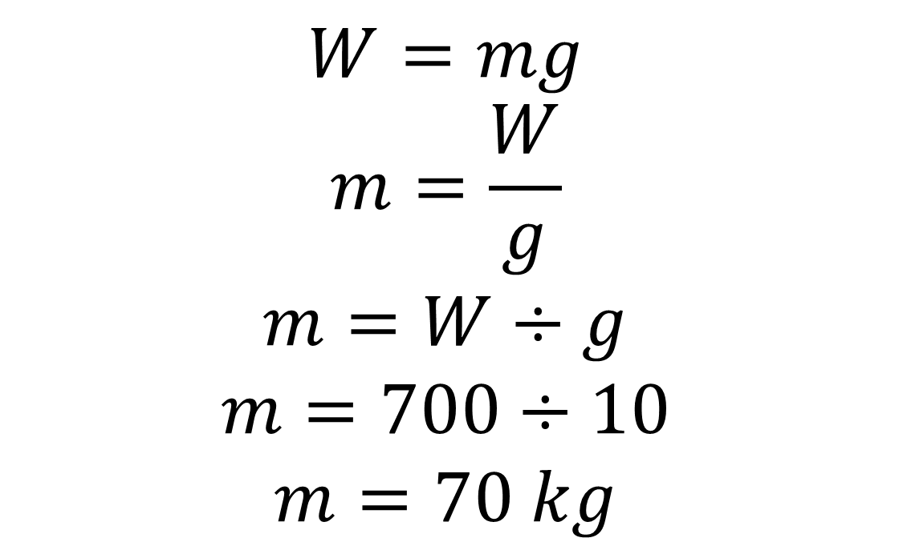
Example 2 – Mass On Earth
Calculate the mass of a person who has a Weight of 700 N
W= 700
m= ?
g= 10
$$W=mg$$
$$m=\frac{W}{g}$$
$$m=W÷g$$
$$m=700÷10$$
$$m=70 kg$$
W
m
g

Slide 127

Working In Jotter – Q1-3 only

Slide 128
Transport Forces
We are learning about Mass and Weight specifically;
Weight on other planets

Slide 129
Success Criteria:
I can state if mass or weight varies on other planets
If I know the gravitational field strength of a planet can calculate either the:
Mass
weight
If I know the gravitational field strength, I can determine the planet.

Slide 130
Mass and Weight on different Planets
Mass stays the same on all planets.
Weight is different on each planet
This is because of the gravitational field strength of different planets.
youtube

Slide 131
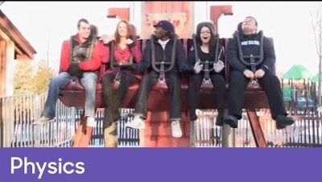

Slide 132
Planet | Gravitational field strength (N/kg)
Earth | 10
Jupiter | 23
Mars | 3.7
Mercury | 3.7
Earth’s Moon | 1.7
Neptune | 11
Saturn | 9
Uranus | 8.7
Venus | 8.9

Slide 133
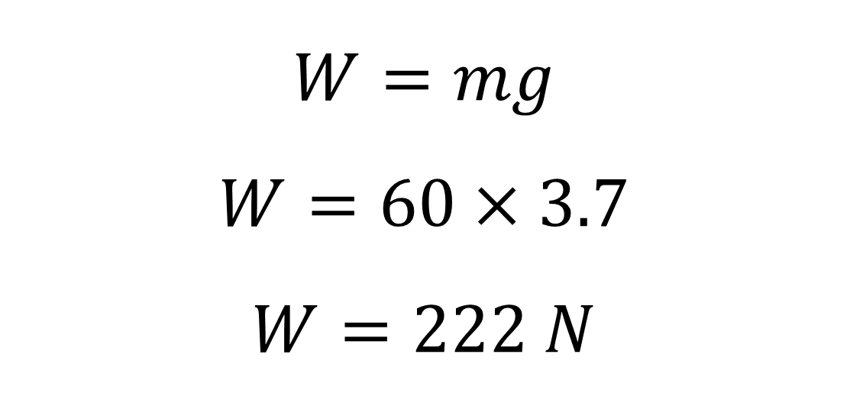
Example 3 – Weight On Another Planet
Calculate the Weight of a person who has a mass of 60kg, when they are standing on mars
Earth | 10
Jupiter | 23
Mars | 3.7
Mercury | 3.7
Earth’s Moon | 1.7
Neptune | 11
Saturn | 9
Uranus | 8.7
Venus | 8.9
W= ?
m= 60
g= 3.7
$$W=mg$$
$$W=60×3.7$$
$$W=222 N$$
W
m
g

Slide 134

Mass and Weight Questions
Questions
Extension

Slide 135
Task
L7 – Mass and Weight – OneNote
QR Code Questions (working in Jotter)

Slide 136
Success Criteria
Describe mass, and state its units
Describe weight and state it’s units
Describe gravitational field strength
What is the equation that links mass and weight
What happens to an objects mass and weight when it goes to the moon?

Slide 137
Daily Review - Whiteboards
How can you reduce friction?
When is friction useful?
What units is mass measured in?
What units is weight measured in?
Paul has a mass of 50kg. What is Pauls weight on earth?

Slide 138
Transport Forces
We are learning about
Magnetic fields

Slide 139
Success Criteria:
I can name the 2 poles of a magnet
I can name the situation with 2 magnets will attract
I can name the situation with 2 magnets will repel
I can sketch the field lines around a bar magnet
I can state the direction field lines must be drawn

Slide 140
Magnets
All magnets have 2 poles (ends),a south pole and a north pole
North and south poles are attracted to each other
Like poles repel each other

Slide 141
Magnets
Place a magnet between a sheet of paper and a sheet of acetate (see through)
Gently sprinkle iron fillings around the magnet
Use the compass to see which ways to draw the arrows (the direction the white arrow points)
Draw a diagram in your jotter
Repeat for the situations on the board

Slide 142
Magnetic Field Lines
Magnetic field lines show the direction a magnetic metal will move in a magnet’s field
The shape of magnetic field lines can be seen using iron filings.
Magnetic field lines are always drawn from north to south

Slide 143
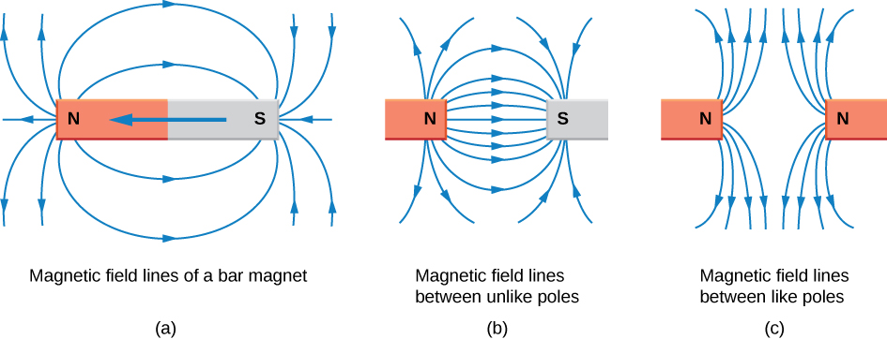
Magnetic Field Lines

Slide 144
Magnetic Field Lines

Slide 145
Success Criteria
Name the 2 poles of a magnet
When will 2 magnets attract?
When will 2 magnets repel?
Sketch the field lines around a bar magnet
What direction must field lines be drawn?

Slide 146
Transport Forces
We are learning about
electromagnets

Slide 147
Success Criteria:
I can state what an electromagnet is
I can suggest a benefit of an electromagnet
I can state a possible use of an electromagnet
I can explain how to make an electromagnet
I can draw a diagram of an electromagnet

Slide 148
Electromagnets
Normal magnets are always ‘on’
Electromagnetic can be switched on an off
Electromagnets can be used in scrapyards to move metal

Slide 149
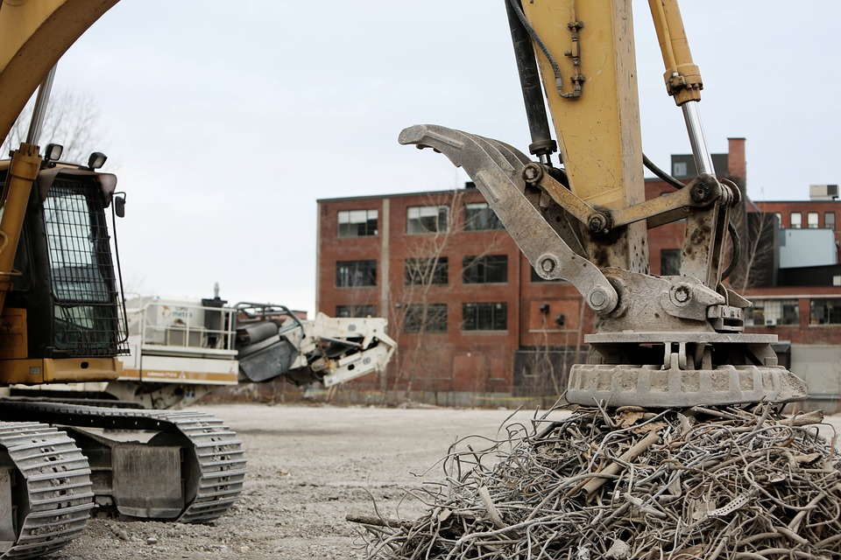

Slide 150
Making an Electromagnet
Electromagnets are made by wrapping coils of wire around an iron core
and connecting it to a power supply.

Slide 151
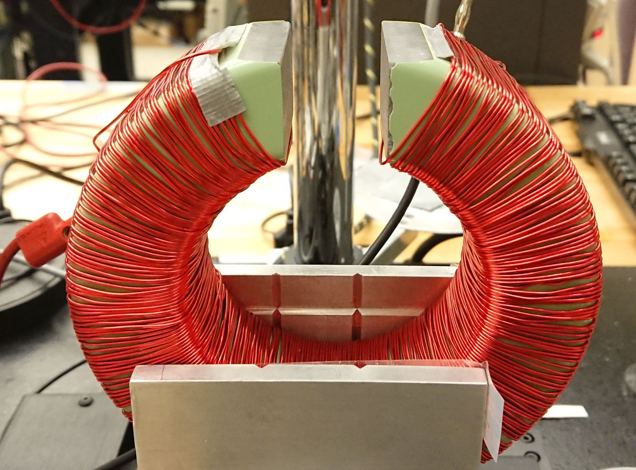

Slide 152
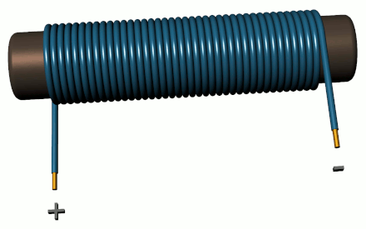

Slide 153
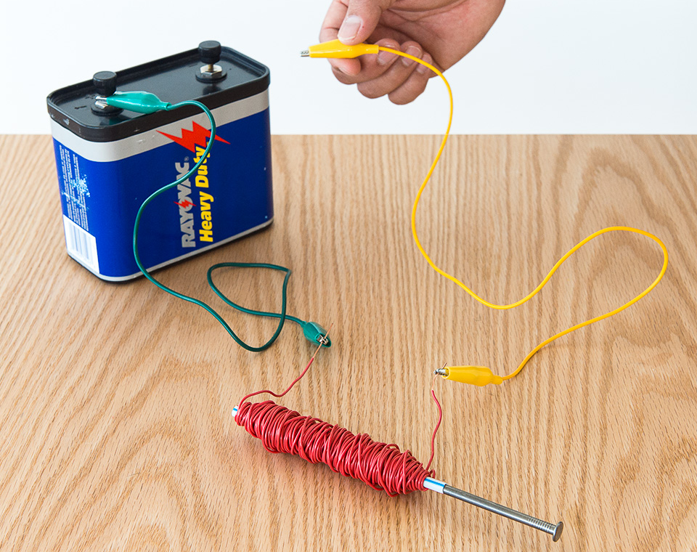

Slide 154
Transport Forces
We are learning about electromagnets, specifically factors affecting its
strength

Slide 155
Success Criteria:
I can state 2 possible ways to change the strength of an electromagnet
I can plan an experiment to observe then effect of the number of coils on the magnetic strength
I can write up my findings in a scientific report.

Slide 156
Aim: To investigate how the number of coils effects the strength of an electromagnet
Hypothesis: The electromagnet will be strongest when_______
Wrap the wire around the nail
Connect each end of the wire to the power supply
Hold nail over paper clips – count how many you pick up
change the number of coils and repeat
3V Lab Pack
2 Leads
Wire
6-inch nail
2 croc clips
Paperclips

Slide 157
Electromagnet Write up - OneNote - Example
Aim & Hypothesis – What are you going to investigate
Variables - Constant, Dependent and Independent
Set up - Measurements, Observations, Resources and H/S
Diagram – Must be labelled
Method – A numbered list
Results – Table
Graph - Graph Paper, Labeled
Conclusion – Answers the aim
Evaluation – Issues and How to improve

Slide 158
Electromagnet Write up - Example
Write up the experiment we have just done.
Your write up must be handed in to your teacher on _______
The write up is worth 20 Marks
2 Marks for each section, 1 Mark for title, and 1 mark for presentation

Slide 159
Learning Logs
Title: Electromagnet Report
Score: /20
Comment: something good and something for improvement

Slide 160
Electromagnet Investigation
Increasing the number of coils increases the strength of an electromagnet
Increasing the supply voltage increases the strength of an electromagnet
youtube

Slide 161
Success Criteria
What is an electromagnet?
What is a benefit of an electromagnet?
What are electromagnets used for?
How do you make an electromagnet?
How can you increase the strength of an electromagnet?

Slide 162
Learning Logs
Title: Forces Topic Test
Score: /20
Comment: something good and something for improvement

Slide 163

Revision
Practice Test (desk)
Knowledge organizer (QR)
Practice questions (QR)
PowerPoint (QR)
Quizlet (QR)
Success Criteria (QR)

Slide 164
water
Water Resistance is caused by friction with .
Air
Air Resistance is caused by friction with .
Investigation:
Aim: To see how the shape of a piece of plasticine affects its Water Resistance .
Diagram
plasticine
measuring cylinder
water
LO: I know what is meant by friction.

Slide 165
Results:
Shape | Time to reach bottom (s)
cube
flat
ball
cone
umbrella
LO: I know what is meant by friction.

Slide 166
Conclusion:
faster
More pointed shapes fall in water.
This is because they have water resistance .
less
An object that has a a shape that causes low water resistance is said to be .
streamlined
aerodynamic
In air, low air resistance objects are .
LO: I know what is meant by friction.

Slide 167
Revision
Why do you think it is important to make cars as streamlined as possible?
To go faster, what sort of position should a skier adopt?
After jumping out of a plane, what can a skydiver do to fall faster.
When sledging a girl found she went faster lying on the sledge than sitting upright. Explain why this is.
Explain how the shape of a submarine helps it to go quickly underwater.
LO: I know what is meant by friction.

Slide 168
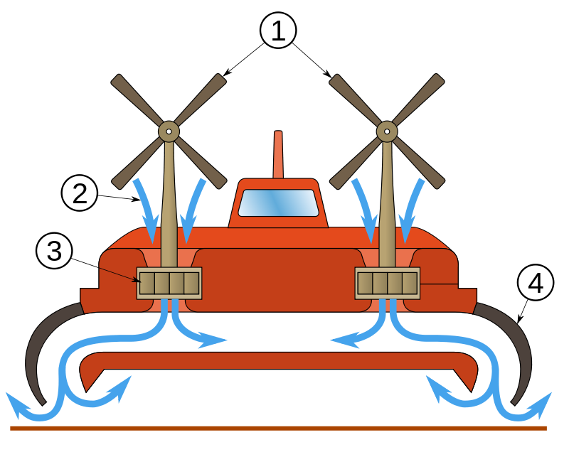
Air can also reduce friction.
The Hovercraft:
LO: I know what is meant by friction.

Slide 169
Parachutes
Parachutes are designed to produce the maximum amount of possible to slow down a skydiver.
air resistance
Maximum air resistance is achieved by giving the parachute the largest possible.
area
Use the worksheet to design a parachute
LO: I know what is meant by friction.

Slide 170
9. Floating
LO: I know why objects float.

Slide 171
When the buoyancy force of water equals the . of an object it will float.
weight
moves
When an object is placed in water it some of the water out of the way.
This is called .
displacement
greater
greater
The the mass of water displaced, the . the buoyancy force.
Using aluminium foil (30cm x 30cm), create a boat that will carry the greatest weight without sinking.
LO: I know what is meant by mass and weight.

